Slide 1

Analyzing and Predicting Amazon Product Sales Over a Month
Siri Smitha Joginapally – BG98738
Manasvi Pentareddy – CZ04458

Slide 2
Introduction
This project is about analyzing Amazon products based on their price, and rating. There are 2 datasets:
amazon_categories.csv:
Id
category_name
amazon_products.csv:
asin
Title
imgUrl
productURL
Stars
Reviews
Price
listPrice
category_id
isBestSeller
boughtInLastMonth
https://www.kaggle.com/datasets/asaniczka/amazon-products-dataset-2023-1-4m-products

Slide 3
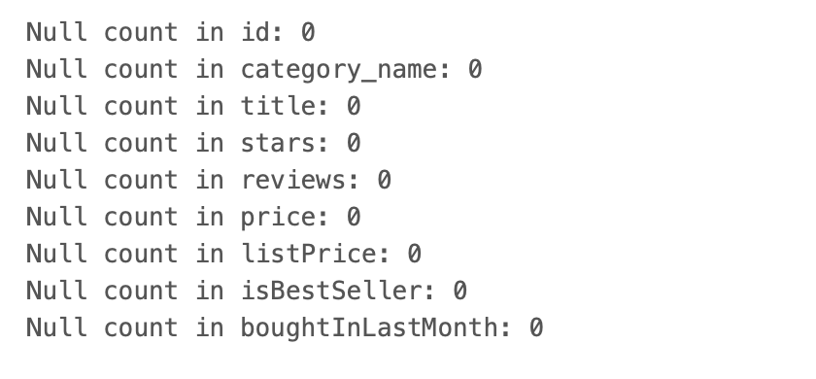
Preprocessing
Merging
Cleaning
Checking for null values
Dropping all the unrequired columns
Changing the datatypes of the columns

Slide 4
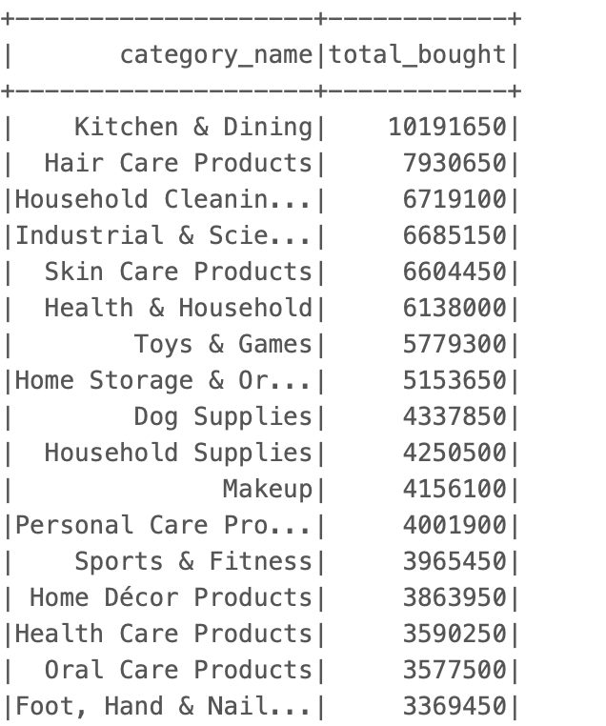
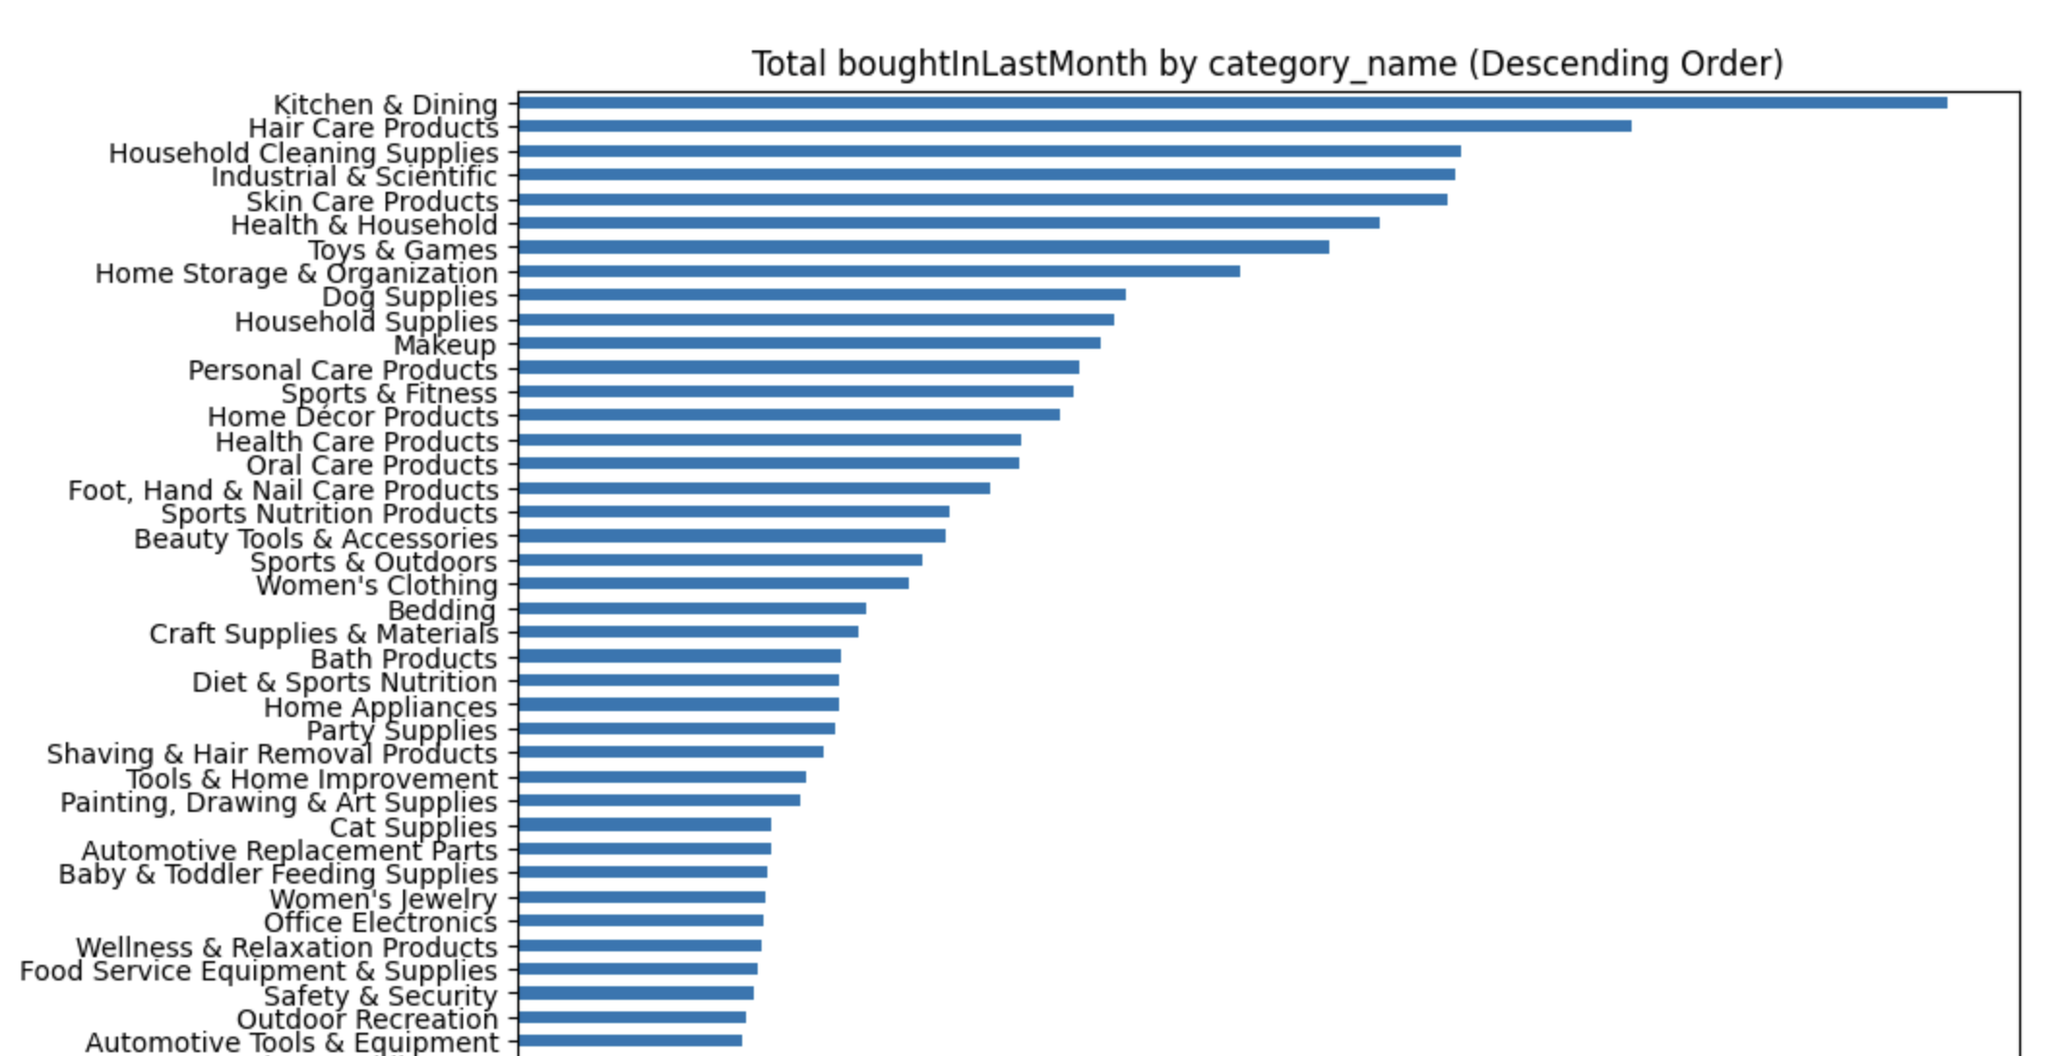
Visualization
Which category based products were sold maximum

Slide 5
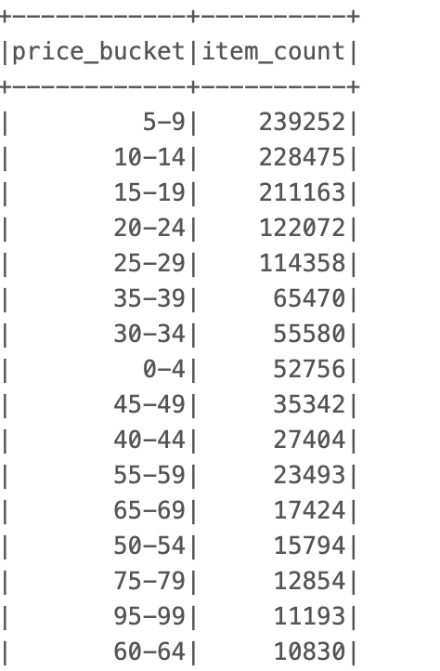
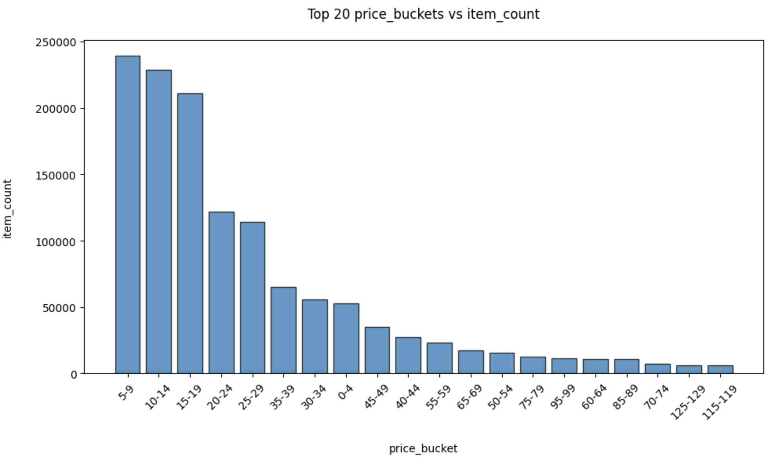
Visualization
In which price range the products are most sold

Slide 6
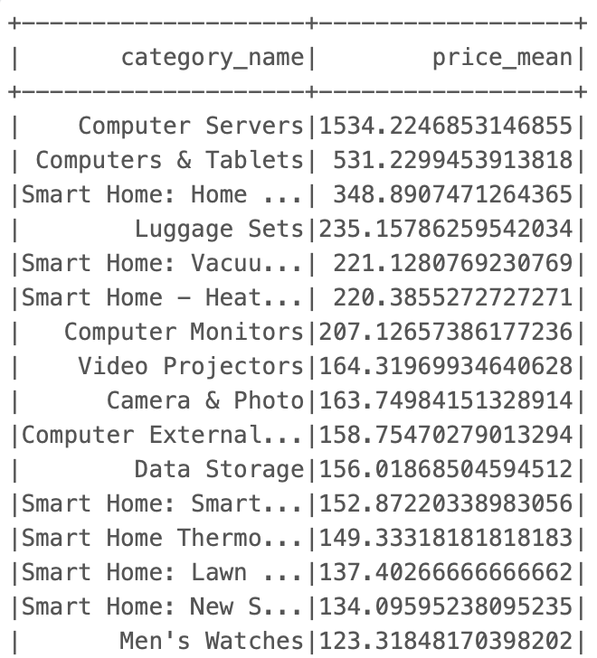
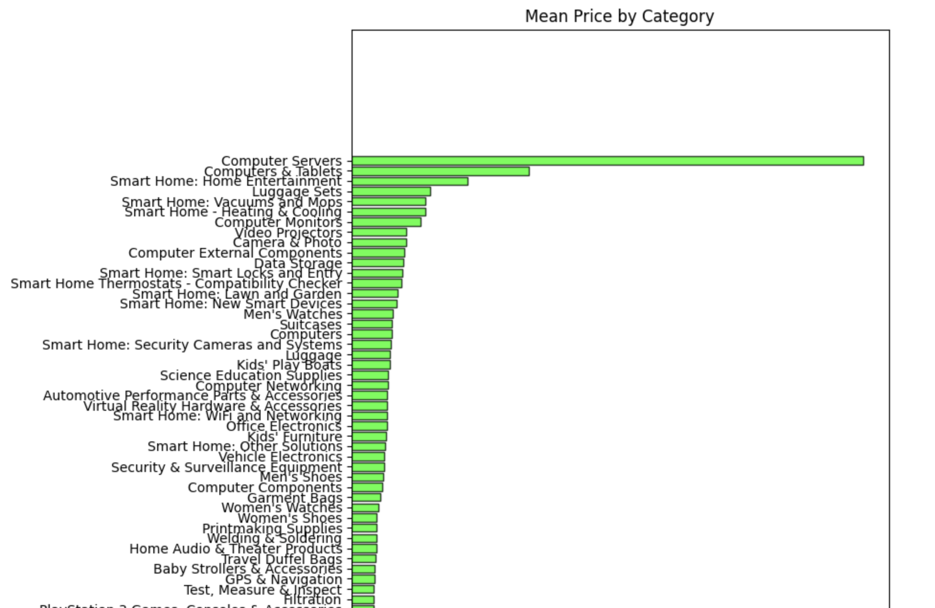
Visualization
What is the average price for each category

Slide 7
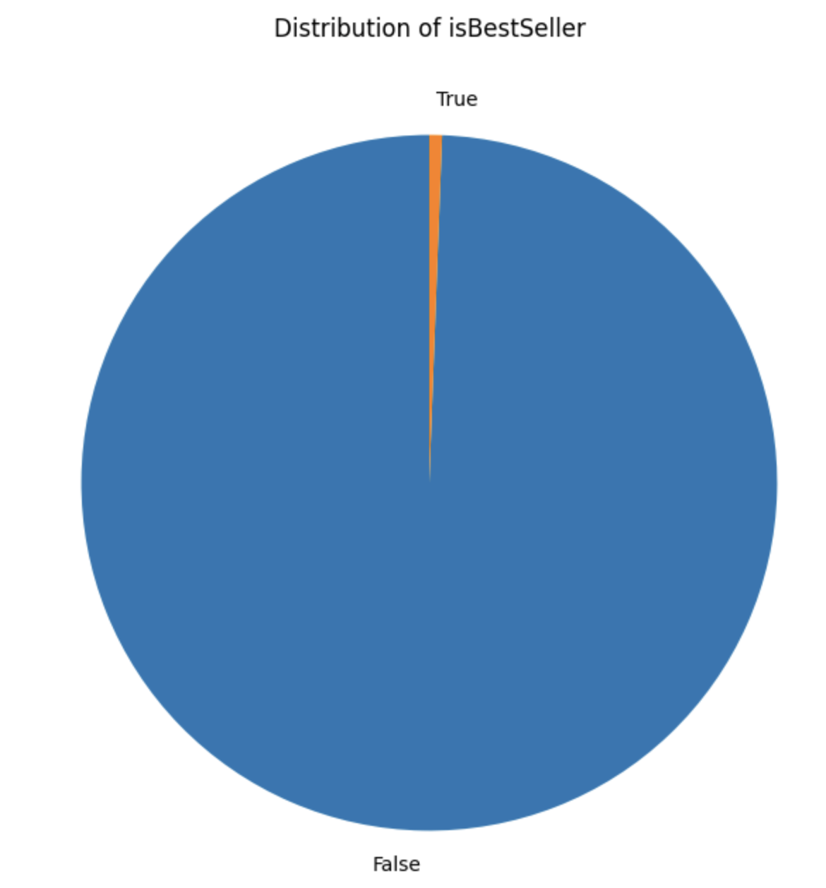
Visualization
Distribution of Best Seller

Slide 8
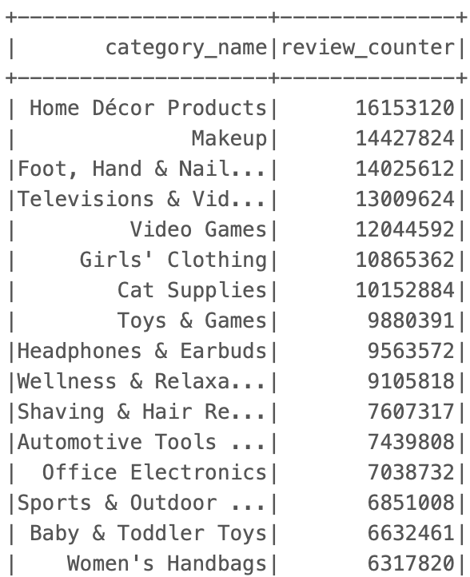
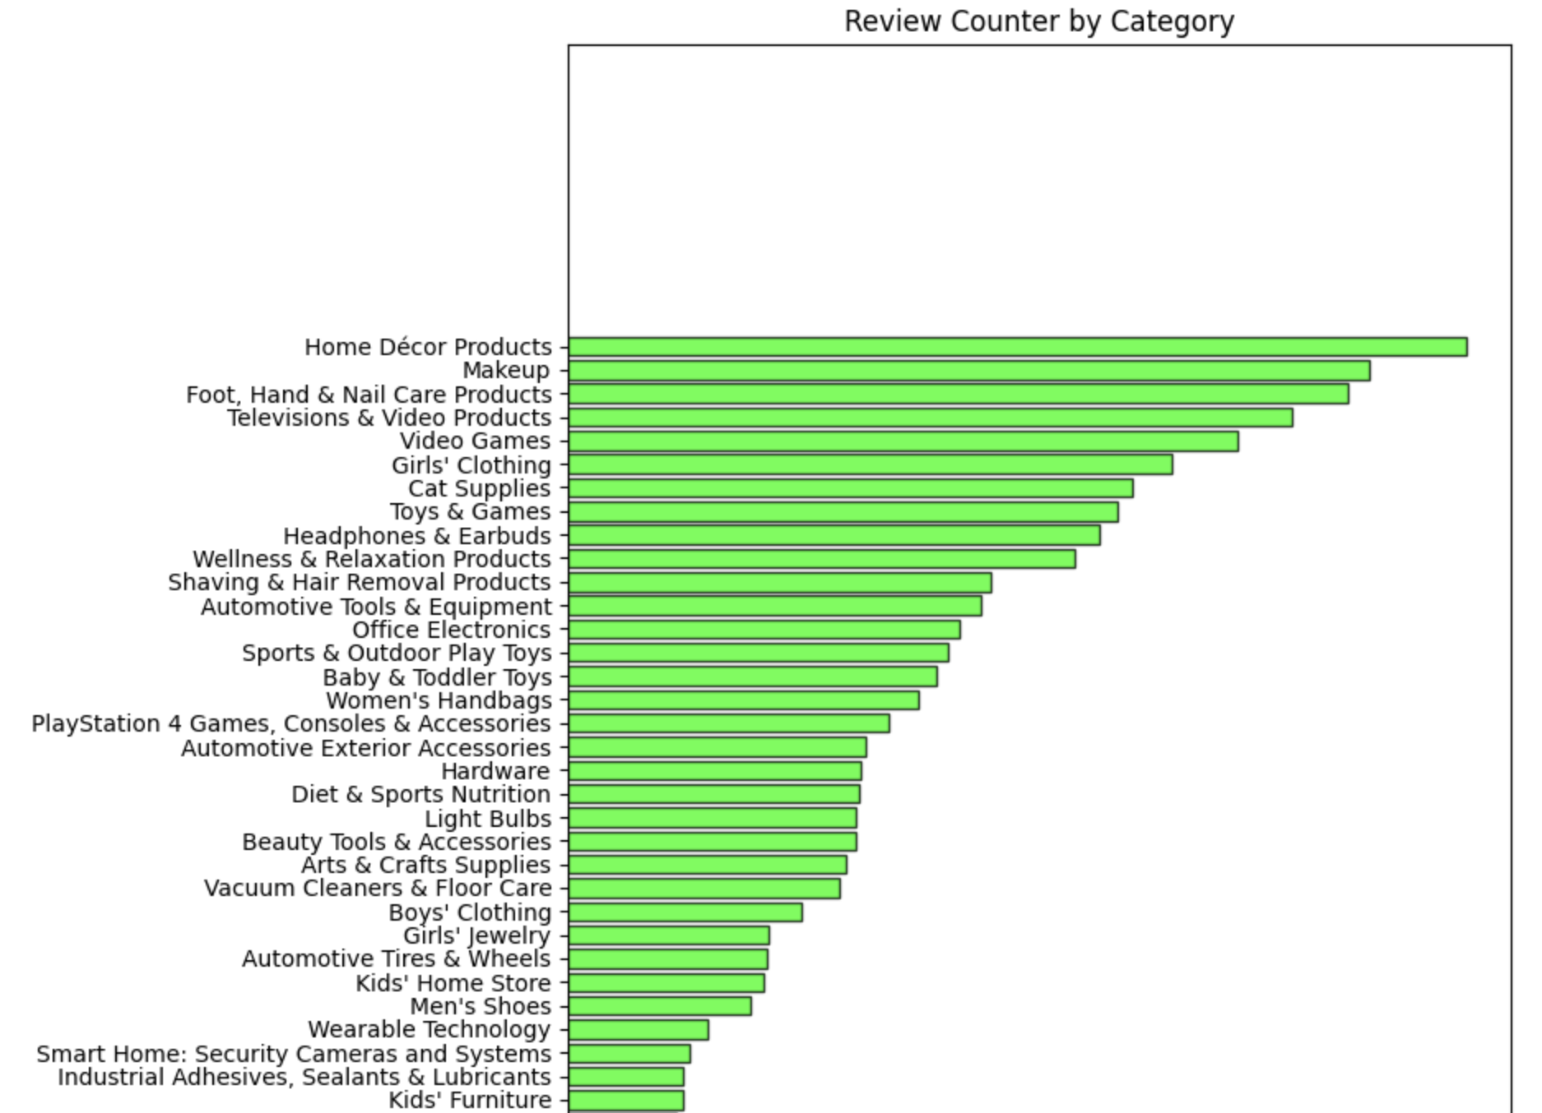
Visualization
Which Category has most number of reviews

Slide 9
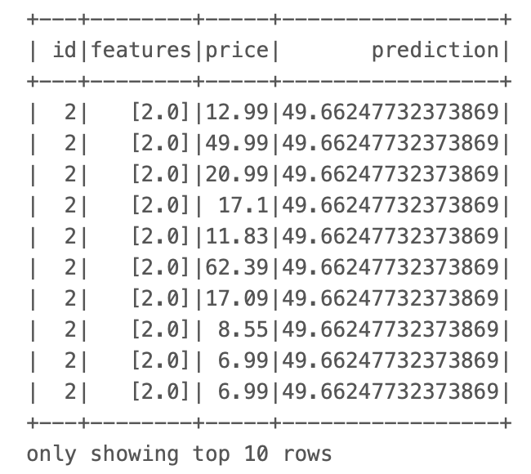
Model Application
We have applied a linear regression model for our data to predict the price of each category in our data and also evaluated the model using Root Mean Squared Error (RMSE).

Slide 10
Conclusion
In this project, we used PySpark to preprocess and transform a dataset containing Amazon product sold listing information. Using linear regression, we built a predictive model to estimate the prices of each category based on features such as reviews, stars, and prices. The model was evaluated using Root Mean Squared Error (RMSE), providing insight into its accuracy in predicting listing prices.

Slide 11
Thank You

